Slide 1
Virtio: An I/O virtualization framework for Linux
2017.05.24
DC Lab
서영근
Distributed Computing Laboratory in SKKU

Slide 2
Content
motivation
Full virtualization vs paravirtualization
VirtIO architecture
VirtIO Transport layer
Data Exchange Flow
Distributed Computing Laboratory in SKKU

Slide 3
motivation
SSD 정리
Linux supports 8 distinct virtualization systems:
Xen, KVM, VMWare, ...
Each of these has its own block, console, network, … drivers
Virtio?
virtio provides a common front end for these device emulations to standardize the interface and increase the reuse of code across the platforms.
virtio is an abstraction layer over devices in a paravirtualized hypervisor.
Distributed Computing Laboratory in SKKU

Slide 4
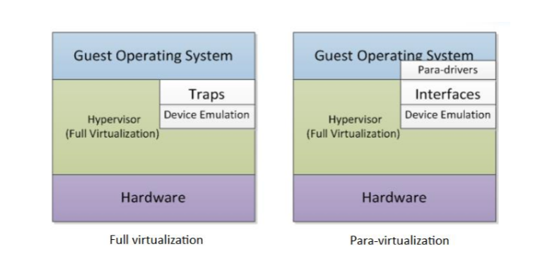
Full virtualization vs paravirtualization
SSD 정리
Distributed Computing Laboratory in SKKU

Slide 5
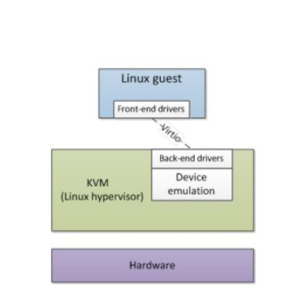
Virtio architecture
SSD 정리
Front End Driver
A kernel module in the guest OS
Accepts I/O requests from the user process
Transfer I/O requests to back-end driver
Back-end Driver
Accepts I/O requests from frontend driver
Perform I/O operation via physical device
Distributed Computing Laboratory in SKKU

Slide 6
Virtio architecture
SSD 정리
Front-end driver
Virtio driver
Virtqueue
Virtio-buffer
vring
back-end driver
Virtio device
qemu
guest
Distributed Computing Laboratory in SKKU

Slide 7
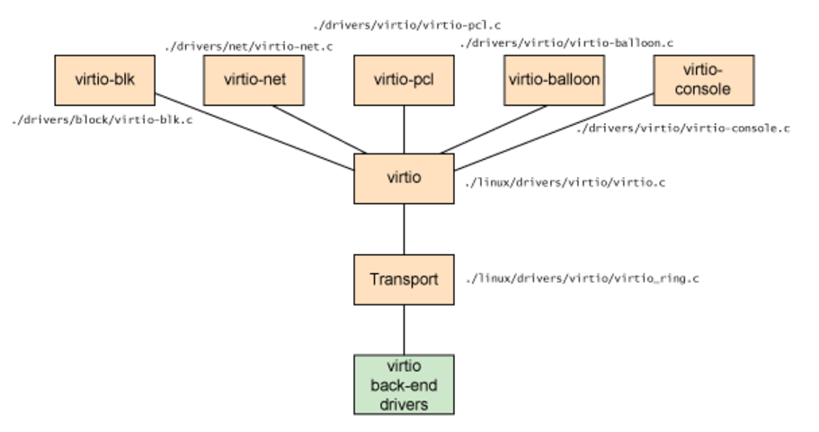
Virtio architecture
SSD 정리
Distributed Computing Laboratory in SKKU

Slide 8
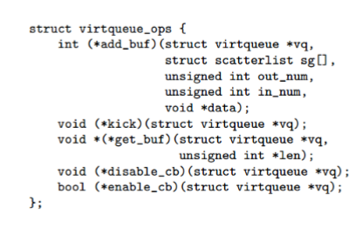
VirtIO Transport layer
SSD 정리
Virtqueue
It is a part of the memory of the guest OS
A channel between front-end and back-end
It is an interface Implemented as Vring
Vring
Vring is a memory mapped region
between QEMU and guest OS
Vring is the memory layout of the
virtqueue abstraction
Distributed Computing Laboratory in SKKU

Slide 9
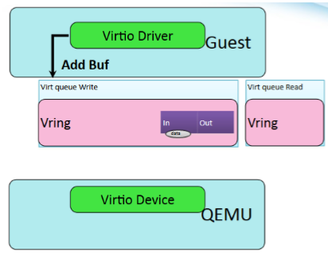
Data Exchange Flow
SSD 정리
Distributed Computing Laboratory in SKKU

Slide 10
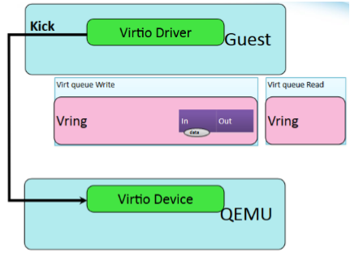
Data Exchange Flow
SSD 정리
Distributed Computing Laboratory in SKKU

Slide 11
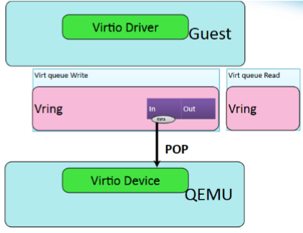
Data Exchange Flow
SSD 정리
Distributed Computing Laboratory in SKKU

Slide 12
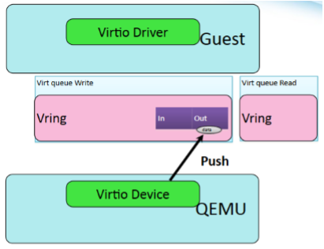
Data Exchange Flow
SSD 정리
Distributed Computing Laboratory in SKKU

Slide 13
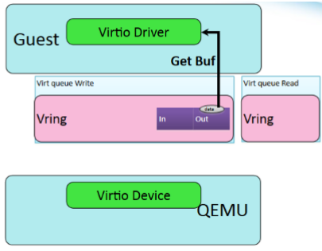
Data Exchange Flow
SSD 정리
Distributed Computing Laboratory in SKKU

Slide 14
감사합니다
Distributed Computing Laboratory in SKKU

